Slide 1
Cluster Monitoring

Slide 2
Introduction
Overview
Remote System Logging
Monitoring Software

Slide 3
Cluster Monitoring

Slide 4
Cluster Monitoring
Introduction
Design feedback
did we design it right?
should use this design again?
how do we scale for next generation?
Auditing and accounting
are we using the hardware fully?
Malicious use detection
Failure detection / prediction
automatic recovery
allocation exclusion
All of this produces lots of data!

Slide 5
Cluster Monitoring
Failure Detection
Overall system health
hardware failures
fan speeds
CPU voltages
temperatures (CPU, mobo)
hard drive errors
network connections
...
software failures
kernel errors
service errors
application errors
...

Slide 6
Remote System Logging
via rsyslog

Slide 7
Remote System Logging
rsyslog
Transmits local system logs to a central log server
facilitates faster problem and trend finding
easier to backup
Filtering reduces transmission overhead
no need to send uninteresting information
Lot of data will still make it to the central server
log compression and rotation is mandatory!

Slide 8
Remote System Logging
rsyslog
Logged events can be placed in
flat files
databases
good for larger clusters
Traffic can be encrypted for sensitive environments
prevents spoofing and intercepts

Slide 9
Cluster Monitoring
Software

Slide 10
Cluster Monitoring Software
Popular Packages
Commercial
Bright Cluster Management
...
Open-Source
Nagios
Ganglia
Zenoss
...

Slide 11
Cluster Monitoring Software
Considerations
Is the system scalable?
What capabilities are needed?
Can you easily add metrics?
Where does the data go (flat files; syslog; database)?
How is all this data gathered?
How much network traffic is caused?
How is data presented (textually; graphically)?
Can automated tasks be triggered?

Slide 12
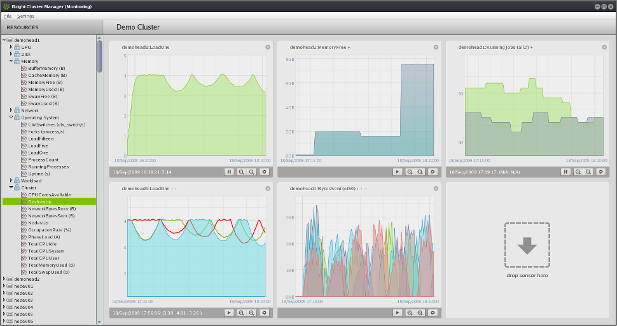
Cluster Monitoring Software
Visualizations
Most monitoring packages provide data visualization for scalability
Notes:
image: http://www.brightcomputing.com/screenshots/linux-cluster-monitoring-wide-970.png

Slide 13

Cluster Monitoring Software
Ganglia Introduction
XML based data
Compiled data serialization (XDR)
Low node overhead
Web interface
Aggregate data from multiple geographic locations
Located in 'epel' repository!
Notes:
Demonstration from Joyent: http://fjrkr5ab.joyent.us/ganglia-2.0/
Demonstration through Wikipedia servers: http://ganglia.wikimedia.org/latest/

Slide 14
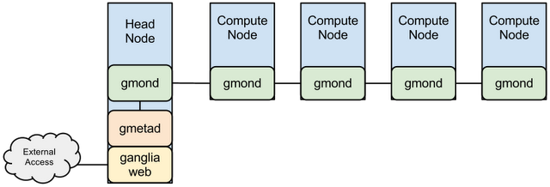
Ganglia
Installation
Multicast Configuration
gmond - back-end daemon
gmetad - front-end daemon
ganglia-web - web interface
Notes:
In multicast all gmond nodes can be configured to listen and talk to broadcast messages. Metrics are cached at each node.

Slide 15
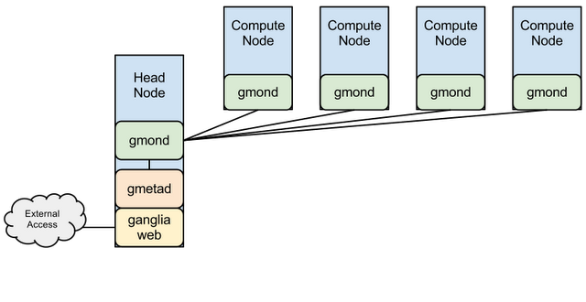
Ganglia Configuration
Unicast Configuration
Notes:
In unicast, one node is set to listen, and all other nodes are set to talk only to it directly (not broadcast).

Slide 16
Summary

Slide 17
Summary
Overview
Remote System Logging
Monitoring Software

Slide 18
Questions

Slide 19
Quiz
Name at least three reasons for using a monitoring solution.
Name two reasons why one would want to setup rsyslog filtering on each child node?
Why is it important to setup compression and rotation of your log files?
Name at least three criteria for selecting a monitoring solution.

